Slide 1

FEAT HUNCH
A PERFORMANCE PREDICTOR IN ML
services
Methods
timeline
about
DASHBOARD
Background

Slide 2

PROJECT MENTOR :
Mr. DEEPAK KUMAR VERMA
Methods
Background
Team
services
timeline
TEAM MEMBERS :
1. Ankit Kumar (1509010035)
2. Amit Kumar Singh (1509010027)
3. Ankit Agrawal (1509010033)
DASHBOARD

Slide 3
Education is a key factor for accomplishing an indelible
economic progress.
Student’s academic performance centers on multiple
aspects, making the analysis quite challenging. In later
years, there has been an increase in the rate of interest
and concern of people in the usage of data mining for
educational and academic purposes.
The goal is to do a comparative study of student’s
performance through different algorithms. For this,
research will be considering various parameters which
affect a student’s success.
One of the focuses of these studies is to identify high-risk
students, as well as to identify features which affect the
performance of students.
Methods
Background
about
services
timeline
DASHBOARD

Slide 4
PROBLEMS :
Major issue is low academic performance of student.
The problem factors are as follows:-
Students’ personal factors.
Faculty related factors.
School/University related factors, to background factors.
Methods
Background
SOLUTIONS :
services
timeline
Objective
DASHBOARD
Intelligent platform for everyone includes:-
Educators and advisors.
Parents and students.
Predicting risk level for students

Slide 5
1
2
3
We wanted to develop an early warning system that identifies student difficulty & disengagement before assessment or any major day of there life.
80% of the most at-risk (failing) candidates
Will be identified by the model. There will
be large differences between the most and
least at-risk students.
services
Background
Methods
DASHBOARD
timeline
Early academic performance predicts later
academic performance very well.
about

Slide 6



services
Background
DASHBOARD
Methods
timeline
about
SURVEY
INFORMATION
GATHERING
INFORMATION IN DATABASE

Slide 7
services
Background
DASHBOARD
Methods
timeline
about
ML PREDICTION
ANALYSIS
RESULT ON
DASHBOARD

Slide 8
The implementation of this study consists of two types of methods:
01
02
Analysis Data.
Methods for Analysis
services
Background
timeline
about
DASHBOARD
Methods
The process of Analysis Data is done through several stages including: Literature review, the study of literature discussing the establishment of a data warehouse and data mining.
In the design phase, design models and applications based on the results of an analysis of the problem are used.

Slide 9



LOW MAINTENANCE
WE HAVE A ROBUST SYSTEM WHICH TAKE LESS AMOUNT OF RESOURCE AND GIVE BEST OUTPUT.
BEST UI EXPERIENCE
WE HAVE A WORLD CLASS UI DASHBOARD WHICH IS EASY TO MANAGE.
services
Background
Methods
DASHBOARD
timeline
about
HIGH ACCURACY
OUR SYSTEM HAVING GOOD AMOUNT OF ACCURACY ON EVERY TYPE OF DATASET.

Slide 10
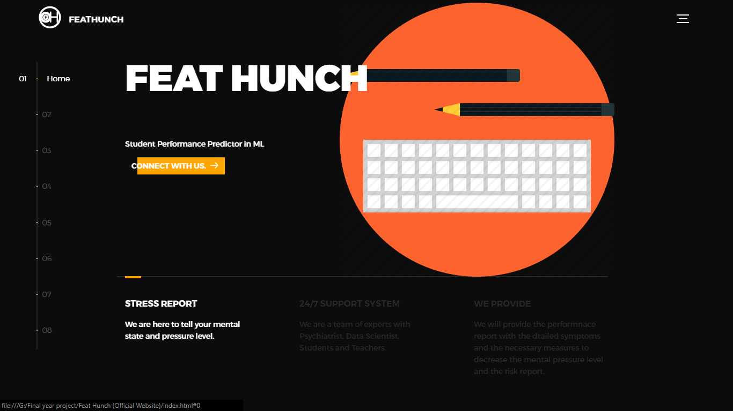
OUR WEBSITE
services
Background
Methods
WEBSITE
timeline
about

Slide 11

OUR WEBSITE
services
Background
Methods
WEBSITE
timeline
about

Slide 12
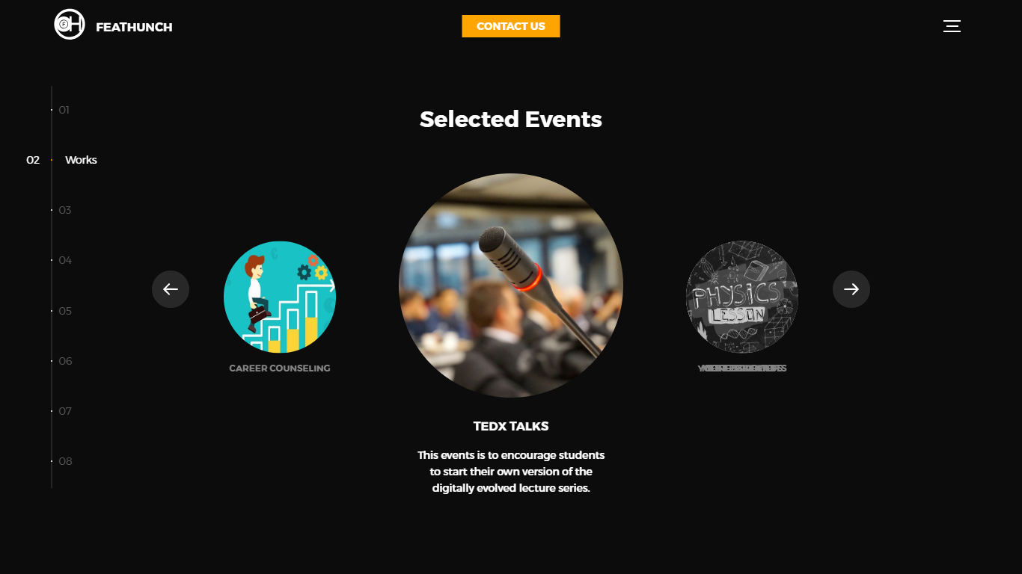
OUR WEBSITE
services
Background
Methods
WEBSITE
timeline
about

Slide 13
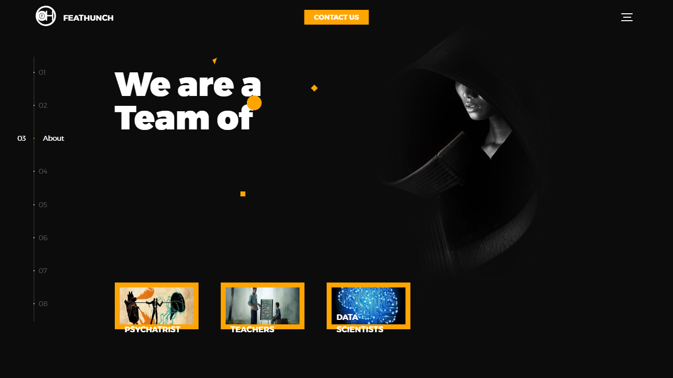
OUR WEBSITE
services
Background
Methods
WEBSITE
timeline
about

Slide 14
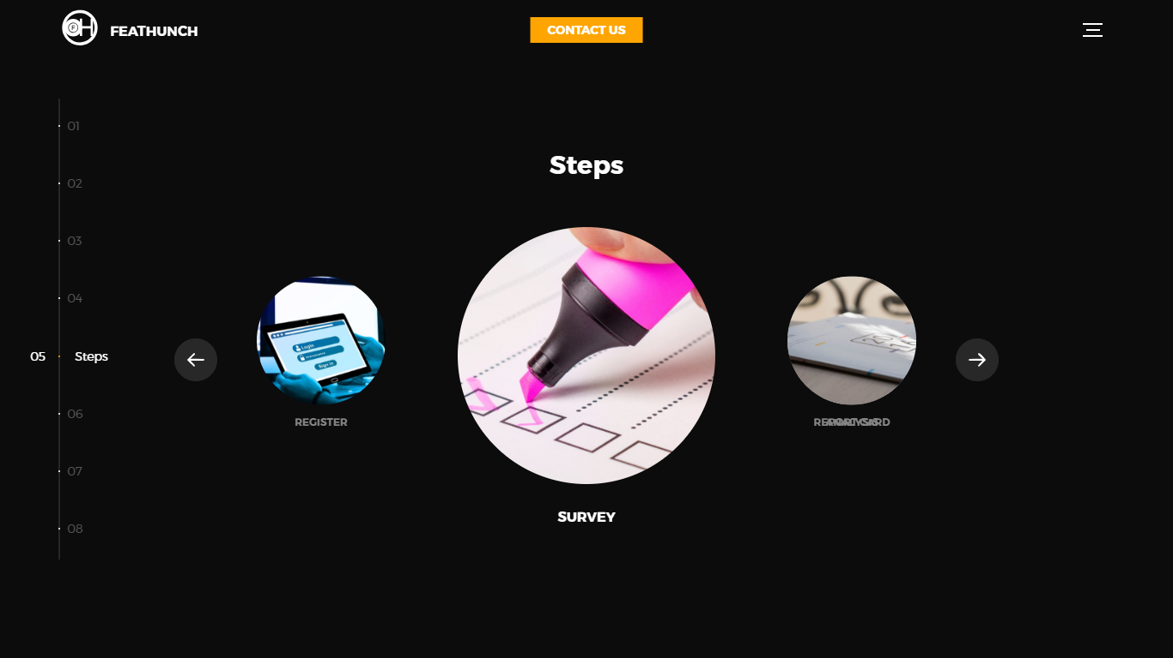
OUR WEBSITE
services
Background
Methods
WEBSITE
timeline
about

Slide 15
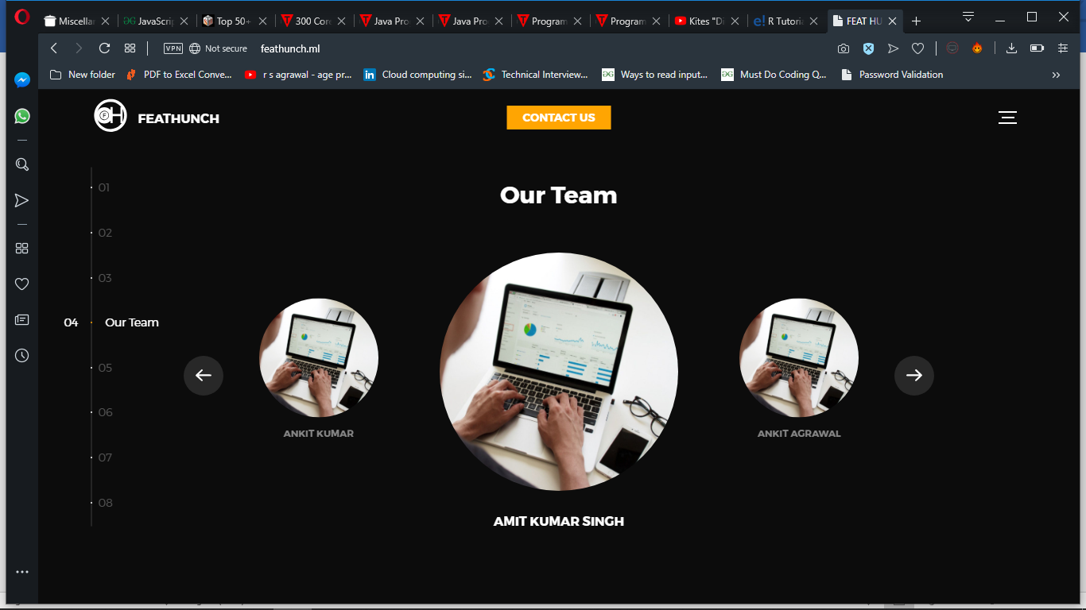
OUR WEBSITE
services
Background
Methods
WEBSITE
timeline
about

Slide 16
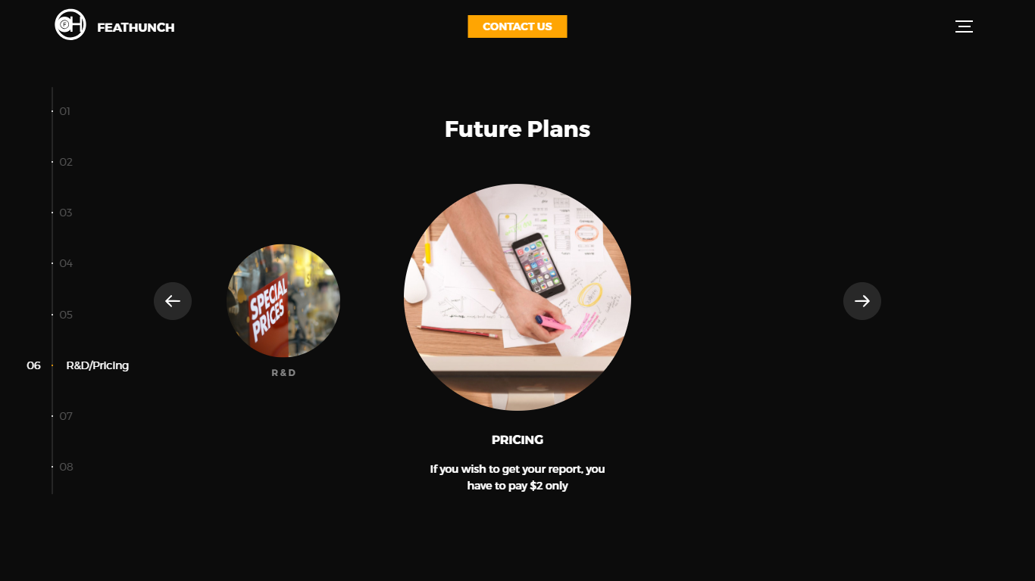
OUR WEBSITE
services
Background
Methods
WEBSITE
timeline
about

Slide 17
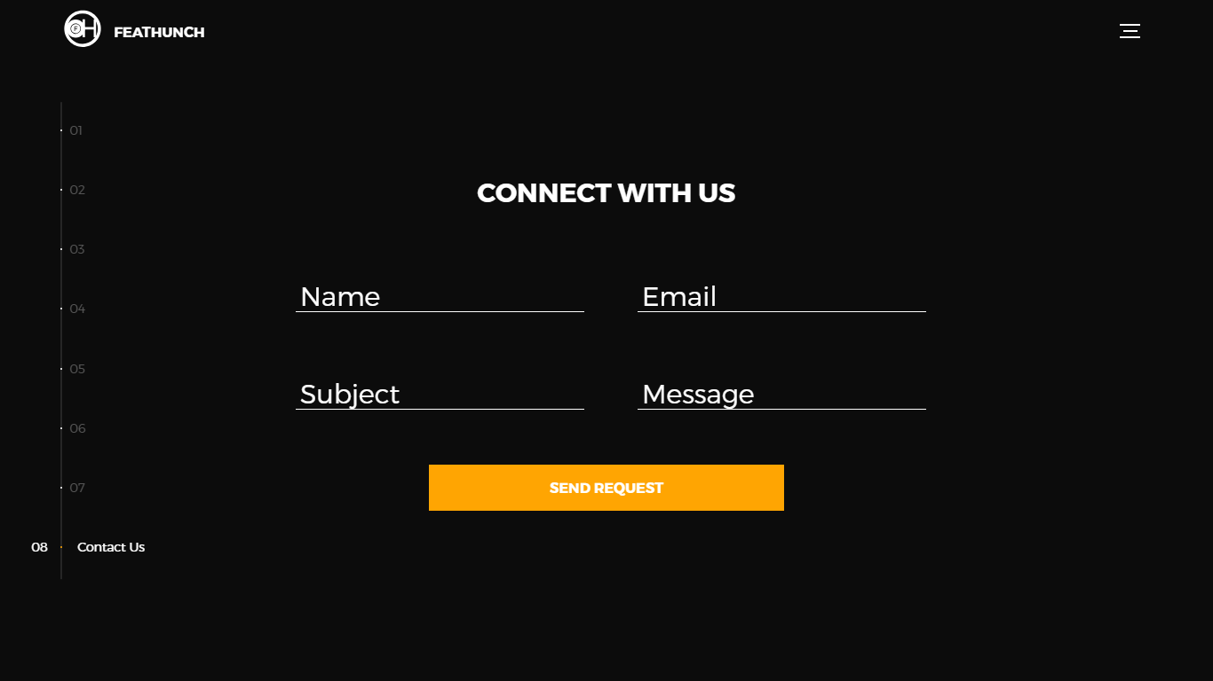
OUR WEBSITE
services
Background
Methods
WEBSITE
timeline
about

Slide 18
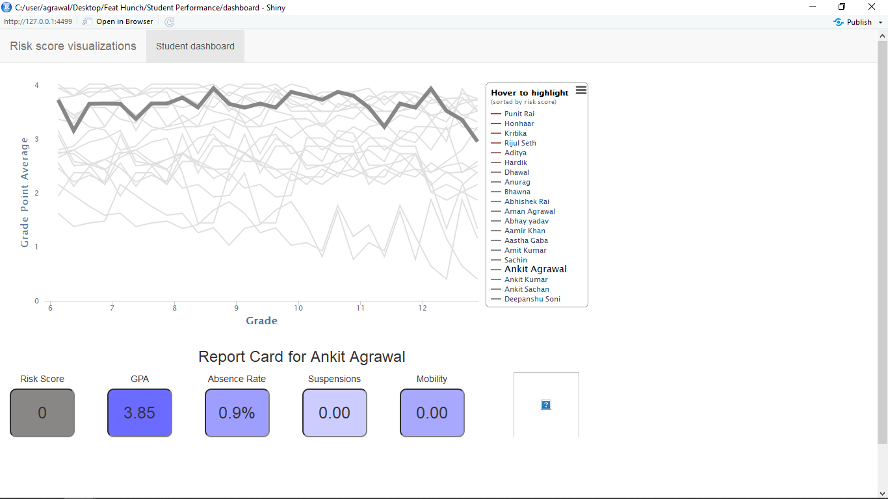
OUR DASHBOARD
services
Background
Methods
DASHBOARD
timeline
about

Slide 19
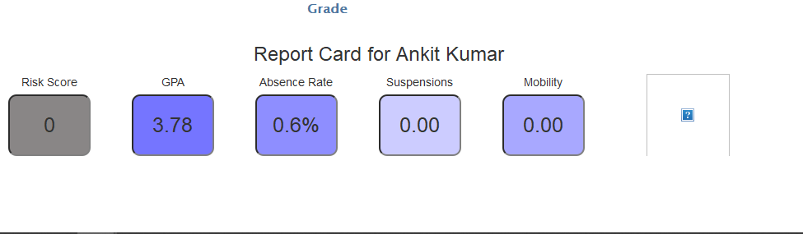
OUR DASHBOARD
services
Background
Methods
DASHBOARD
timeline
about

Slide 20
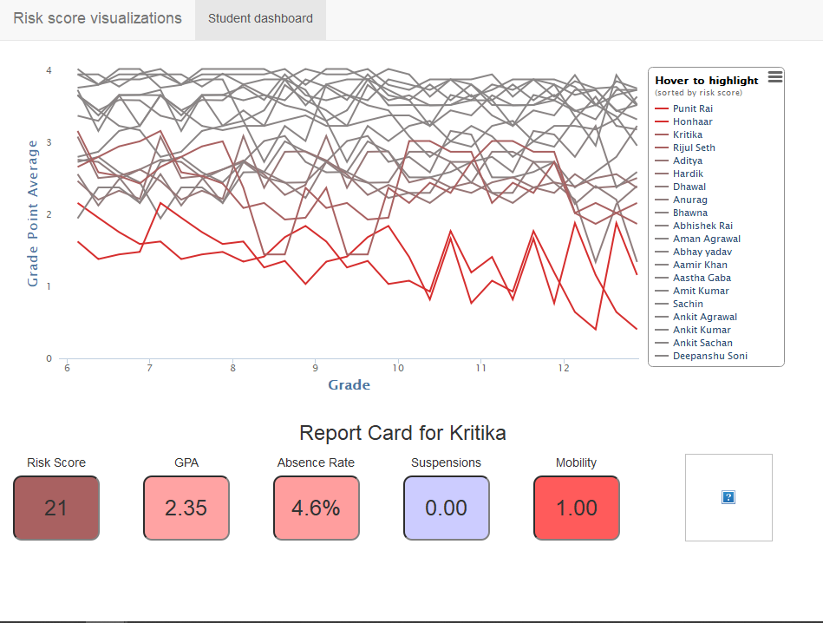
OUR DASHBOARD
services
Background
Methods
DASHBOARD
timeline
about

Slide 21
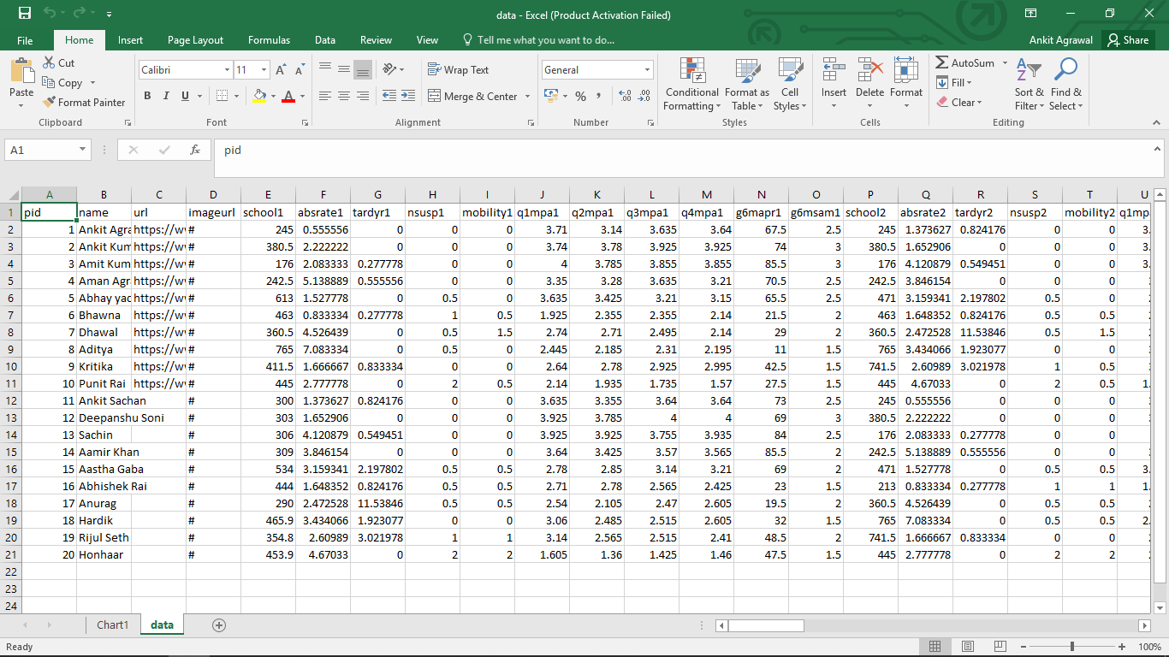
OUR DATASET
services
Background
Methods
DATASET
timeline
about

Slide 22
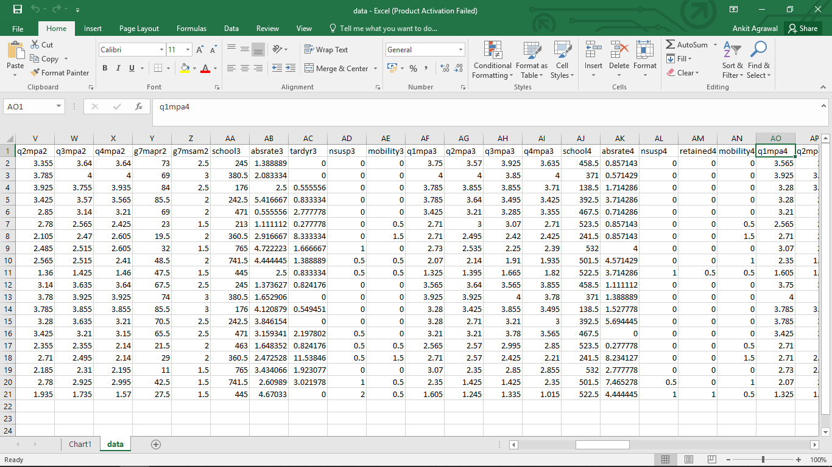
OUR DATASET
services
Background
Methods
DATASET
timeline
about

Slide 23
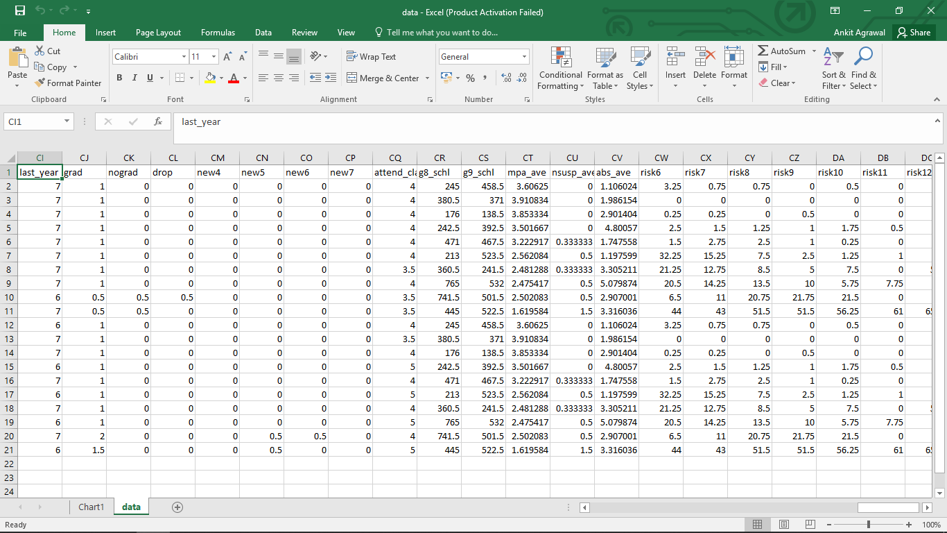
OUR DATASET
services
Background
Methods
DATASET
timeline
about

Slide 24
THANK YOU
services
Background
Methods
THANKS
timeline
about

